Slide 1
CS326 Parallel and Distributed Computing
Fall 2021
National University of Computer and Emerging Sciences

Slide 2
Chapter 7. Programming Shared Address Space Platforms

Slide 3
OpenMP: a Standard for Directive Based Parallel Programming
OpenMP is a directive-based API that can be used with FORTRAN, C, and C++ for programming shared address space machines.
OpenMP directives provide support for concurrency, synchronization, and data handling while obviating the need for explicitly setting up mutexes, condition variables, data scope, and initialization.

Slide 4
OpenMP directives in C and C++ are based on the #pragma compiler directives.
#pragma omp directive [clause list]
OpenMP programs execute serially until they encounter the parallel directive.
#pragma omp parallel [clause list]
This directive is responsible for creating a group of threads.
The exact number of threads can be specified in the directive, set using an environment variable, or at runtime using OpenMP functions.
The main thread that encounters the parallel directive becomes the master of this group of threads and is assigned the thread id 0 within the group.

Slide 5
Each thread created by this directive executes the structured block specified by the parallel directive.
#pragma omp parallel [clause list]
/* structured block */
The clause list is used to specify conditional parallelization, number of threads, and data handling.

Slide 6
Conditional Parallelization: The clause if (scalar expression) determines whether the parallel construct results in creation of threads.
Only one if clause can be used with a parallel directive.
Degree of Concurrency: The clause num_threads (integer expression) specifies the number of threads that are created by the parallel directive.

Slide 7
Data Handling
The clause private (variable list) indicates that the set of variables specified is local to each thread – i.e., each thread has its own copy of each variable in the list.
The clause firstprivate (variable list) is similar to the private clause, except the values of variables on entering the threads are initialized to corresponding values before the parallel directive.
The clause shared (variable list) indicates that all variables in the list are shared across all the threads, i.e., there is only one copy. Special care must be taken while handling these variables by threads to ensure serializability.

Slide 8
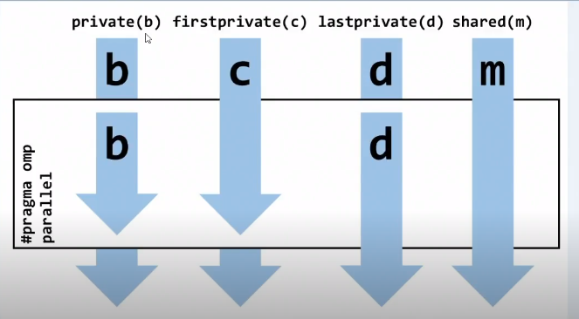

Slide 9
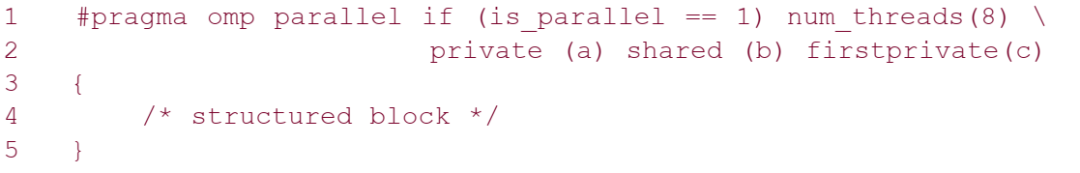
Using the parallel directive
Here, if the value of the variable is_parallel equals one, eight threads are created.
Each of these threads gets private copies of variables a and c, and shares a single value of variable b.
Furthermore, the value of each copy of c is initialized to the value of c before the parallel directive.

Slide 10
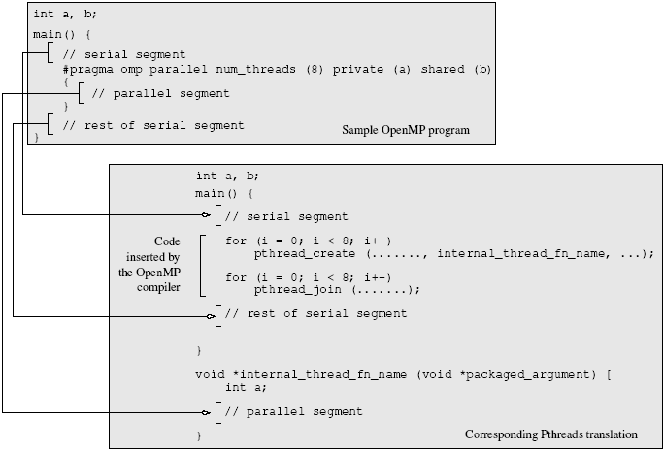
A sample OpenMP program along with its Pthreads translation that might be performed by an OpenMP compiler.

Slide 11
Clause | Description
private | Declares variables to be private to each thread in a team. Private copies of the variable are initialized from the original object when entering the region.
firstprivate | Provides a superset of the functionality provided by the private clause. Each private data object is initialized with the value of the original object.
lastprivate | Provides a superset of the functionality provided by the private clause. The original object is updated with the value of the private copy from the last sequential iteration of the associated loop, or the lexically last section construct, when exiting the region.
shared | Shares variables among all the threads in a team.
default | Enables you to affect the data-scope attributes of variables.
reduction | Performs a reduction on scalar variables.
ordered | The structured block following an ordered directive is executed in the order in which iterations would be executed in a sequential loop.

Slide 12
Clause | Description
if (expression) | If the if(expression)clause is present, the enclosed code block is executed in parallel only if the expression evaluates to TRUE. Otherwise the code block is serialized. The expression must be scalar logical.
schedule | Specifies how iterations of the for loop are divided among the threads of the team.
collapse(n) | Specifies how many loops are associated with the OpenMP loop construct for collapsing.
copyin | Provides a mechanism to copy the data values of the master thread to the variables used by the threadprivate copies at the beginning of the parallel region.
copyprivate | Provides a mechanism to use a private variable to broadcast a value from the data environment of one implicit task to the data environments of the other implicit tasks belonging to the parallel region.
nowait | Indicates that an implementation may omit the barrier at the end of the worksharing region.
untied | Indicates that a resumed task does not have to be executed by same thread executing it before it was suspended.
mergeable | Indicates that the task defined by this task pragma need not create a private data environment for the task, but if the task execution is deferred, then the private data environment is created.
final(expr) | The expr is evaluated, and if the value is true, then this task and all its descendant tasks are non-deferred (not executed in parallel).

Slide 13
The default state of a variable is specified by the clause default(shared) or default (none).
The clause default (shared) implies that, by default, a variable is shared by all the threads.
The clause default (none) implies that the state of each variable used in a thread must be explicitly specified. This is generally recommended, to guard against errors arising from unintentional concurrent access to shared data.

Slide 14
reduction clause
Just as firstprivate specifies how multiple local copies of a variable are initialized inside a thread, the reduction clause specifies how multiple local copies of a variable at different threads are combined into a single copy at the master when threads exit.
The OpenMP reduction clause lets you specify one or more thread-private variables that are subject to a reduction operation at the end of the parallel region.
OpenMP predefines a set of reduction operators. Each reduction variable must be a scalar (for example, int, long, and float).
OpenMP also defines several restrictions on how reduction variables are used in a parallel region.

Slide 15

The operator can be one of $+$, *, -, &, |, ^, &&, and ||

Slide 16
#pragma omp parallel reduction(+: sum) num_threads(8)
{
/* compute local sums here */
}
/* sum here contains sum of all local instances of sums
*/
In this example, each of the eight threads gets a copy of the variable sum.
When the threads exit, the sum of all of these local copies is stored in the single copy of the variable (at the master thread) .

Slide 17
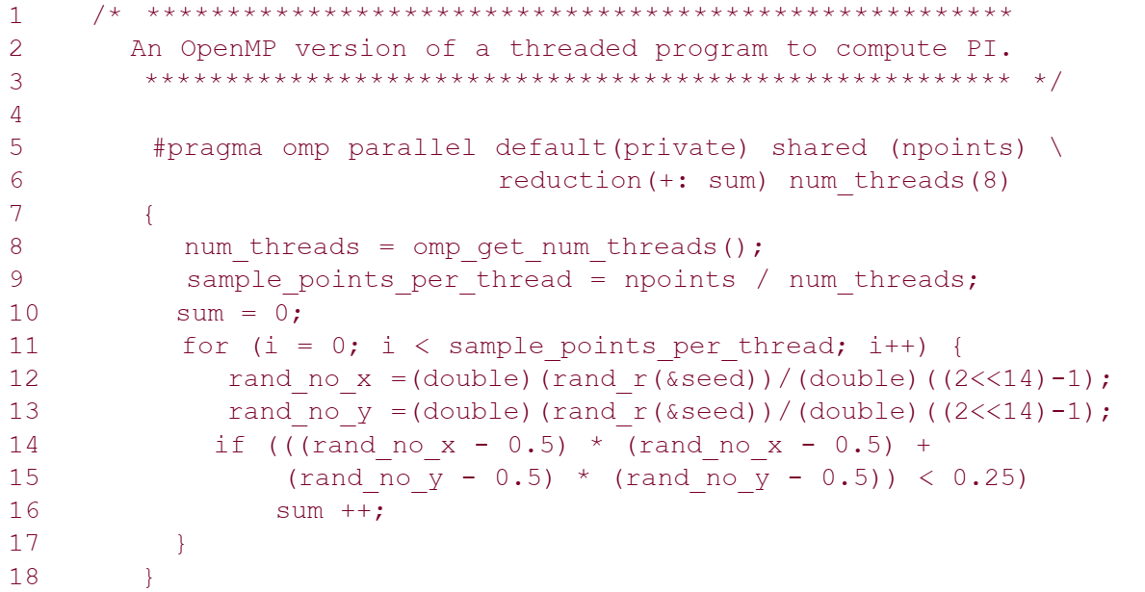

Slide 18
Specifying Concurrent Tasks in OpenMP
The parallel directive can be used in conjunction with other directives to specify concurrency across iterations and tasks.
OpenMP provides two directives – for and sections – to specify concurrent iterations and tasks.

Slide 19
The for Directive
The for directive is used to split parallel iteration spaces across threads. The general form of a for directive is as follows:
#pragma omp for [clause list]
/* for loop */
The clauses that can be used in this context are: private, firstprivate, lastprivate, reduction, schedule, nowait, and ordered.

Slide 20
The for Directive
When using a for loop for farming work to threads, it is sometimes desired that the last iteration (as defined by serial execution) of the for loop update the value of a variable.
This is accomplished using the lastprivate directive.
The lastprivate clause deals with how multiple local copies of a variable are written back into a single copy at the end of the parallel for loop.

Slide 21
Assigning Iterations to Threads
The schedule clause of the for directive deals with the assignment of iterations to threads.
The general form of the schedule directive is schedule(scheduling_class[, parameter]).
OpenMP supports four scheduling classes: static, dynamic, guided, and runtime.

Slide 22
Assigning Iterations to Threads
The general form of the static scheduling class is schedule(static[,chunk-size]).
E.g. The following for loop will be divided in 4 chunks, each with 5 iterations:
#pragma omp parallel for schedule(static, 5) num_threads(4)
for (i = 0; i < 20; i++)
When no chunk-size is specified, the total iterations are split into as many chunks as there are threads and one chunk is assigned to each thread.

Slide 23
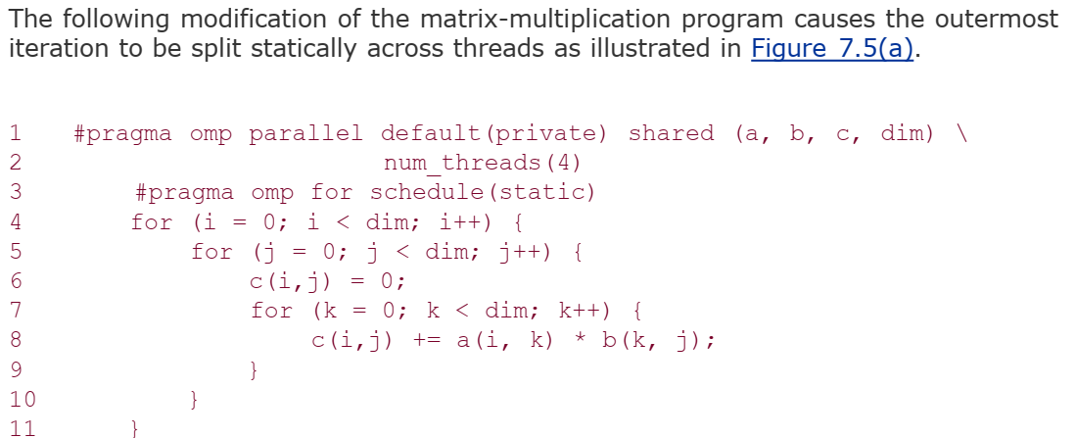

Slide 24
Dynamic
Often, because of a number of reasons, like heterogeneous computing resources to non-uniform processor loads, equally partitioned workloads take widely varying execution times.
For this reason, OpenMP has a dynamic scheduling class.
The general form of this class is schedule(dynamic[, chunk-size])
The iteration space is partitioned into chunks given by chunk-size. However, these are assigned to threads as they become idle.
This takes care of the temporal imbalances resulting from static scheduling. If no chunk-size is specified, it defaults to a single iteration per chunk.

Slide 25
// Enable OpenMP in Properties -> C / C++ -> Language
#include "stdafx.h"
#include <iostream>
#include <omp.h>
#include <stdio.h>
#define N 16
using namespace std;
void printVar(int a[], int b, int c, int d, int m) {
cout << "b = " << b << ", c = " << c << ", d = " << d << " m = " << m << endl;
cout << "a = ";
for (int i = 0; i < N; i++)
cout << a[i] << ", ";
cout << endl;
}

Slide 26
int main(){
int i;
int a[N];
int b = 0, c = 0, d = 0, m = 0;
cout << "Before par. for" << endl;
printVar(a, b, c, d, m); //Garbage Values
#pragma omp parallel for default(none) private(i,b) firstprivate(c) lastprivate(d) shared(m,a) schedule(static, 3) num_threads(4)
for (i = 0; i < N; i++) {
// b and d must be initialized
b = 100;
d = 10;
printf("Thread %d, iteration %d: b = %d, c = %d, d = %d, m = %d\n", omp_get_thread_num(), i, b, c, d, m);
a[i] = omp_get_thread_num();
b = omp_get_thread_num();
c = omp_get_thread_num();
d = omp_get_thread_num();
m = omp_get_thread_num();
}
cout << "After par. for" << endl;
printVar(a, b, c, d, m);
getchar();
return 0;
}

Slide 27
Guided
Consider the partitioning of an iteration space of 100 iterations with a chunk size of 5. This corresponds to 20 chunks. If there are 16 threads, in the best case, 12 threads get one chunk each and the remaining four threads get two chunks. this assignment results in considerable idling.
The solution to this problem (also referred to as an edge effect) is to reduce the chunk size as we proceed through the computation. This is the principle of the guided scheduling class.
The general form of this class is schedule(guided[, chunk-size]).
In this class, the chunk size is reduced exponentially as each chunk is dispatched to a thread. The chunk-size refers to the smallest chunk that should be dispatched.

Slide 28
Runtime
Often it is desirable to delay scheduling decisions until runtime.
For example, if one would like to see the impact of various scheduling strategies to select the best one, the scheduling can be set to runtime.
In this case the environment variable OMP_SCHEDULE determines the scheduling class and the chunk size.

Slide 29
Synchronization Across Multiple for Directives
Often, it is desirable to have a sequence of for-directives within a parallel construct that do not execute an implicit barrier at the end of each for directive.
OpenMP provides a clause – nowait, which can be used with a for directive to indicate that the threads can proceed to the next statement without waiting for all other threads to complete the for loop execution.

Slide 30
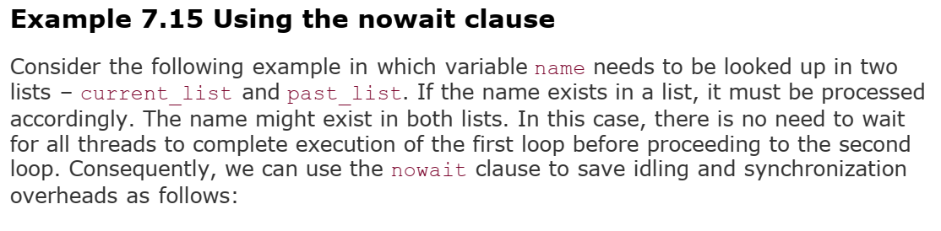

Slide 31
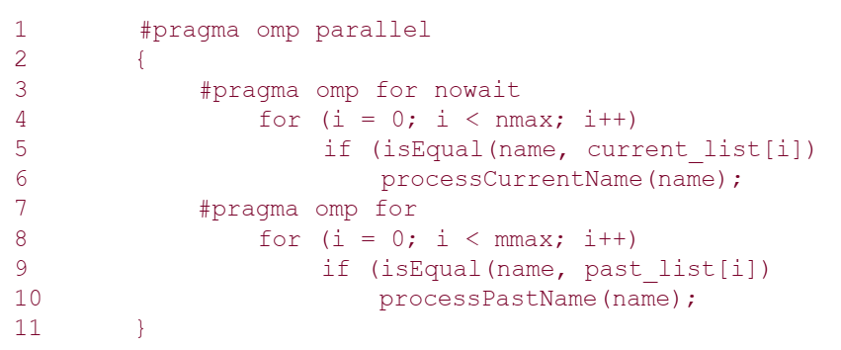

Slide 32
The sections Directive
OpenMP supports such non-iterative parallel task assignment using the sections directive.
The general form of the sections directive is as follows:
#pragma omp sections [clause list]
{
[#pragma omp section
/* structured block */
]
[#pragma omp section
/* structured block */
]
...
}

Slide 33
The sections Directive
This sections directive assigns the structured block corresponding to each section to one thread
(indeed more than one section can be assigned to a single thread).
The clause list may include the following clauses – private, firstprivate, lastprivate, reduction, and nowait.

Slide 34
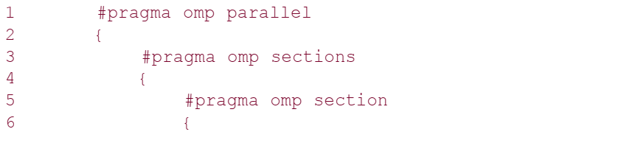
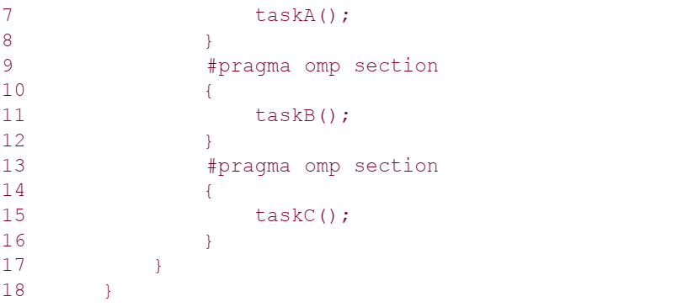

Slide 35
Class Task
Write a Parallel C++ program to calculate WORDCOUNT of some text file. Your program must have reduction clause, and also display the local results of each thread.

Slide 36
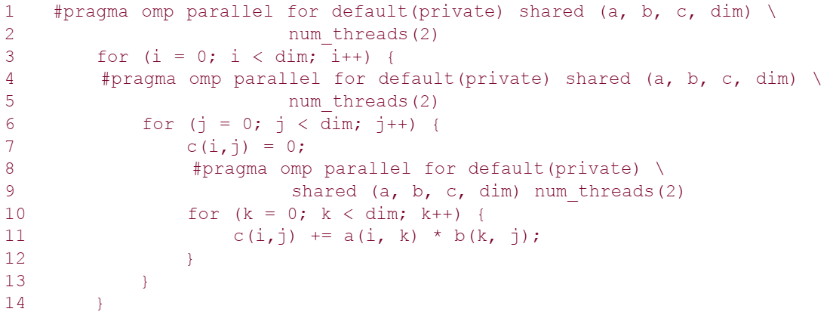
Nesting parallel Directives

Slide 37
The code as written only generates a logical team of threads on encountering a nested parallel directive.
The newly generated logical team is still executed by the same thread corresponding to the outer parallel directive.
To generate a new set of threads, nested parallelism must be enabled using the OMP_NESTED environment variable.
If the OMP_NESTED environment variable is set to FALSE, then the inner parallel region is serialized and executed by a single thread.
If the OMP_NESTED environment variable is set to TRUE, nested parallelism is enabled.

Slide 38
Synchronization Constructs in OpenMP
The need for coordinating the execution of multiple threads may be the result of a desired execution order, the atomicity of a set of instructions, or the need for serial execution of code segments.
The Pthreads API supports mutexes and condition variables.

Slide 39
The barrier Directive
OpenMP provides a barrier directive, whose syntax is as follows:
#pragma omp barrier
On encountering this directive, all threads in a team wait until others have caught up, and then release.
When used with nested parallel directives, the barrier directive binds to the closest parallel directive.
For executing barriers conditionally, it is important to note that a barrier directive must be enclosed in a compound statement that is conditionally executed.

Slide 40
Single Thread Executions: The single and master Directives
Often, a computation within a parallel section needs to be performed by just one thread.
A simple example of this is the computation of the mean of a list of numbers.
A single directive specifies a structured block that is executed by a single (arbitrary) thread.
The syntax of the single directive is as follows:
#pragma omp single [clause list]
/* structured block */

Slide 41
Single Thread Executions: The single and master Directives
On encountering the single block, the first thread enters the block. All the other threads proceed to the end of the block.
If the nowait clause has been specified at the end of the block, then the other threads proceed; otherwise they wait at the end of the single block for the thread to finish executing the block.

Slide 42
Single Thread Executions: The single and master Directives
The master directive is a specialization of the single directive in which only the master thread executes the structured block.
The syntax of the master directive is as follows:
#pragma omp master
/* structured block */

Slide 43
Critical Sections: The critical and atomic Directives
In our discussion of Pthreads, we had examined the use of locks to protect critical regions
OpenMP provides a critical directive for implementing critical regions.
The syntax of a critical directive is:
#pragma omp critical [(name)]
structured block

Slide 44
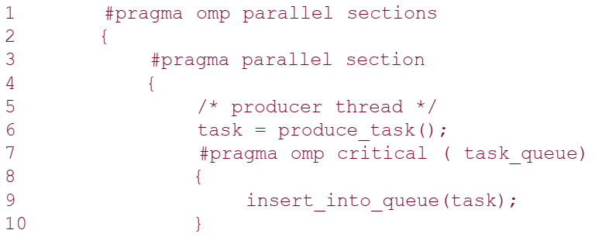
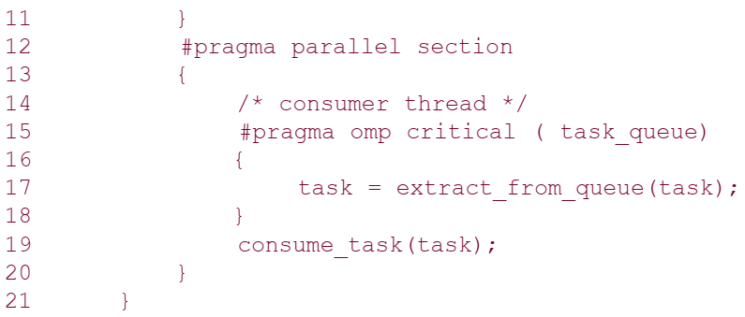

Slide 45
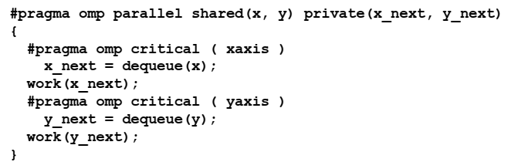

Slide 46
Critical Sections: The critical and atomic Directives
It is easy to see that the critical directive is a direct application of the corresponding mutex function in Pthreads.
There are some obvious safeguards that must be noted while using the critical directive.
The block of instructions must represent a structured block, i.e., no jumps are permitted into or out of the block.
Jumping in would result in non-critical access and jumping out would result in an unreleased lock, which could cause the threads to wait indefinitely.

Slide 47
In-Order Execution: The ordered Directive
In many circumstances, it is necessary to execute a segment of a parallel loop in the order in which the serial version would execute it.
For example, consider a for loop in which, at some point, we compute the cumulative sum in array cumul_sum of a list stored in array list.
The array cumul_sum can be computed using a for loop over index i serially by executing cumul_sum[i] = cumul_sum[i-1] + list[i].
When executing this for loop across threads, it is important to note that cumul_sum[i] can be computed only after cumul_sum[i-1] has been computed.
Therefore, the statement would have to executed within an ordered block.

Slide 48
In-Order Execution: The ordered Directive
The syntax of the ordered directive is as follows:
#pragma omp ordered
structured block
Since the ordered directive refers to the in-order execution of a for loop, it must be within the scope of a for or parallel for directive.
Furthermore, the for or parallel for directive must have the ordered clause specified to indicate that the loop contains an ordered block.
Ordered sections are useful for sequentially ordering the output from work that is done in parallel

Slide 49
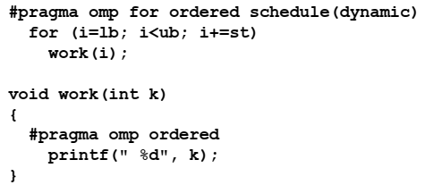

Slide 50
Chapter 6. Programming Using the Message Passing Paradigm

Slide 51
Recall…
A message-passing platform consists of p processing nodes, each with its own exclusive address space.
Interactions between processes running on different nodes must be accomplished using messages (data, work, and to synchronize actions among the processes), hence the name message passing.
The basic operations in this programming paradigm are send and receive.
The message-passing programming paradigm is one of the oldest and most widely used approaches for programming parallel computers.

Slide 52
Principles of Message-Passing Programming
The two key attributes to characterize the message-passing programming paradigm.
The first is that it assumes a partitioned address space
Second is that it supports only explicit parallelization.
There are two immediate implications of a partitioned address space.
First, each data element must belong to one of the partitions of the space; hence, data must be explicitly partitioned and placed.
The second implication is that all interactions (read-only or read/write) require cooperation of two processes - the process that has the data and the process that wants to access the data

Slide 53
Principles of Message-Passing Programming
Message-passing programs are often written using the asynchronous or loosely synchronous paradigms
In the asynchronous paradigm, all concurrent tasks execute asynchronously.
However, such programs can be harder to reason about, and can have nondeterministic behavior due to race conditions .
In the loosely synchronous model, tasks or subsets of tasks synchronize to perform interactions. Between these interactions, tasks execute completely asynchronously.
Most message-passing programs are written using the single program multiple data (SPMD) model.
Notes:
The message-passing programming paradigm requires that the parallelism is coded explicitly by the programmer.
In its most general form, the message-passing paradigm supports execution of a different program on each of the p processes. This provides the ultimate flexibility in parallel programming, but makes the job of writing parallel programs effectively unscalable.
In SPMD programs the code executed by different processes is identical except for a small number of processes (e.g., the "root" process)

Slide 54
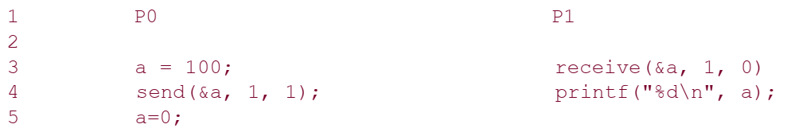
The Building Blocks: Send and Receive Operations
In their simplest form, the prototypes of these operations are defined as follows:
send(void *sendbuf, int nelems, int dest)
receive(void *recvbuf, int nelems, int source)
Notes:
The semantics of the send operation require that the value received by process P1 must be 100 as opposed to 0.
This motivates the design of the send and receive protocols.

Slide 55
The semantics of the send operation require that the value received by process P1 must be 100 as opposed to 0.
This motivates the design of the send and receive protocols.

Slide 56
Blocking Message Passing Operations
A simple method for forcing send/receive semantics is for the send operation to return only when it is safe to do so.
In the non-buffered blocking send, the operation does not return until the matching receive has been encountered at the receiving process.
Idling and deadlocks are major issues with non-buffered blocking sends.

Slide 57
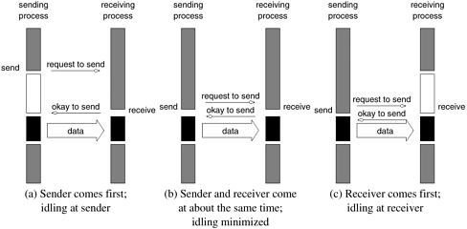
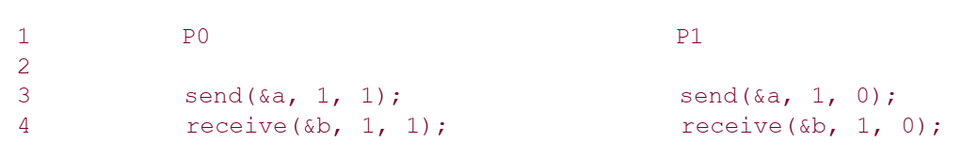

Slide 58
In buffered blocking sends, the sender simply copies the data into the designated buffer and returns after the copy operation has been completed.
The data is copied at a buffer at the receiving end as well.
Buffering alleviates idling at the expense of copying overheads.

Slide 59
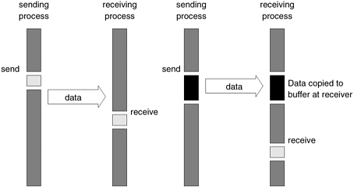
Blocking buffered transfer protocols: (a) in the presence of communication hardware with buffers at send and receive ends; and (b) in the absence of communication hardware, sender interrupts receiver and deposits data in buffer at receiver end.

Slide 60
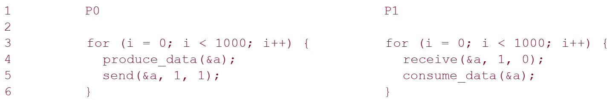
What if consumer was much slower than producer?
This can often lead to unforeseen overheads and performance degradation.

Slide 61
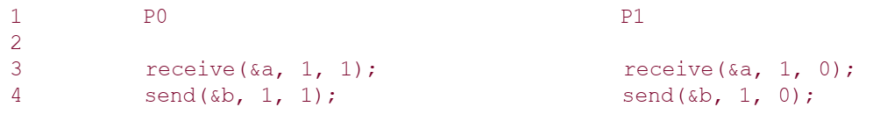
Deadlocks are still possible with buffering since receive operations block.

Slide 62
Non-Blocking Message Passing Operations
This class of non-blocking protocols returns from the send or receive operation before it is semantically safe to do so.
Non-blocking operations are generally accompanied by a check-status operation.
When used correctly, these primitives are capable of overlapping communication overheads with useful computations.
Message passing libraries typically provide both blocking and non-blocking primitives.

Slide 63
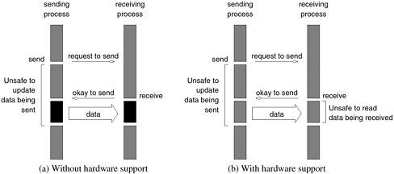

Slide 64
MPI: the Message Passing Interface (Chapter#6)
MPI defines a standard library for message-passing that can be used to develop portable message-passing programs using either C or Fortran.
The MPI standard defines both the syntax as well as the semantics of a core set of library routines.
The MPI library contains over 125 routines, but the number of key concepts is much smaller, it is possible to write fully-functional message-passing programs by using only the six routines
These routines are used to initialize and terminate the MPI library, to get information about the parallel computing environment, and to send and receive messages.

Slide 65
MPI: the Message Passing Interface
MPI_Init | Initializes MPI.
MPI_Finalize | Terminates MPI.
MPI_Comm_size | Determines the number of processes.
MPI_Comm_rank | Determines the label of calling process.
MPI_Send | Sends a message.
MPI_Recv | Receives a message.

Slide 66
Starting and Terminating MPI Library
MPI_Init is called prior to any calls to other MPI routines.
Its purpose is to initialize the MPI environment.
Calling MPI_Init more than once during the execution of a program will lead to an error.
MPI_Finalize is called at the end of the computation, and it performs various cleanup tasks to terminate the MPI environment.
No MPI calls may be performed after MPI_Finalize has been called, not even MPI_Init

Slide 67
Starting and Terminating MPI Library
MPI_Init is called prior to any calls to other MPI routines.
Its purpose is to initialize the MPI environment.
Calling MPI_Init more than once during the execution of a program will lead to an error.
MPI_Finalize is called at the end of the computation, and it performs various cleanup tasks to terminate the MPI environment.
No MPI calls may be performed after MPI_Finalize has been called, not even MPI_Init

Slide 68
The prototypes of these two functions are:
int MPI_Init(int *argc, char ***argv)
int MPI_Finalize()
All MPI routines, data-types, and constants are prefixed by “MPI_”.

Slide 69
Communicators
A key concept used throughout MPI is that of the communication domain.
A communication domain is a set of processes that are allowed to communicate with each other.
Information about communication domains is stored in variables of type MPI_Comm, that are called communicators .

Slide 70
Communicators
A process can belong to many different (possibly overlapping) communication domains
MPI defines a default communicator called MPI_COMM_WORLD which includes all the processes.

Slide 71
Communicators
Communicator holds a group of processes that can communicate with each other.
All message passing calls in MPI must have a specific communicator to use the call with.
An example of a communicator handle is MPI_COMM_WORLD. MPI_COMM_WORLD is the default communicator that contains all processes available for use.
Can be created and destroyed during program execution.

Slide 72
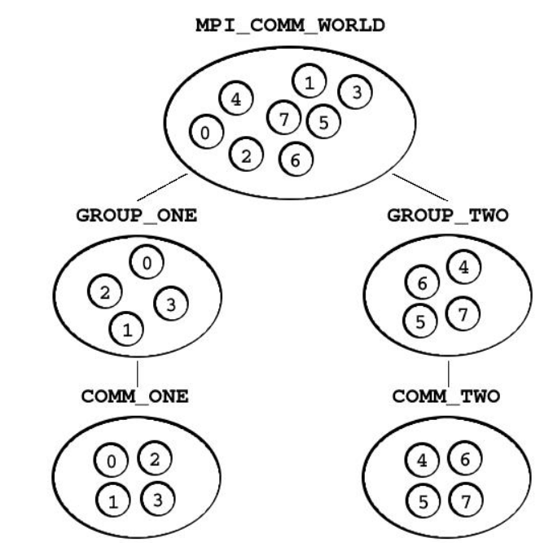

Slide 73
Getting Information
The MPI_Comm_size and MPI_Comm_rank functions are used to determine the number of processes and the label of the calling process, respectively.
The calling sequences of these routines are as follows:
int MPI_Comm_size(MPI_Comm comm, int *size)
int MPI_Comm_rank(MPI_Comm comm, int *rank)
The rank of a process is an integer that ranges from zero up to the size of the communicator minus one.

Slide 74
Our First MPI Program
#include <mpi.h>
main(int argc, char *argv[])
{
int npes, myrank;
MPI_Init(&argc, &argv);
MPI_Comm_size(MPI_COMM_WORLD, &npes);
MPI_Comm_rank(MPI_COMM_WORLD, &myrank);
printf("From process %d out of %d, Hello World!\n", myrank, npes);
MPI_Finalize();
}

Slide 75
MPI Datatypes
MPI Datatype | C Datatype
MPI_CHAR | signed char
MPI_SHORT | signed short int
MPI_INT | signed int
MPI_LONG | signed long int
MPI_UNSIGNED_CHAR | unsigned char
MPI_UNSIGNED_SHORT | unsigned short int
MPI_UNSIGNED | unsigned int
MPI_UNSIGNED_LONG | unsigned long int
MPI_FLOAT | float
MPI_DOUBLE | double
MPI_LONG_DOUBLE | long double
MPI_BYTE
MPI_PACKED

Slide 76
Running an MPI Program
mpicc program_name.c -o object_file
mpirun -np [number of processes] ./object_file

Slide 77
The basic functions for sending and receiving messages in MPI are the MPI_Send and MPI_Recv respectively.
int MPI_Send(void *buf, int count, MPI_Datatype datatype,
int dest, int tag, MPI_Comm comm)
int MPI_Recv(void *buf, int count, MPI_Datatype datatype,
int source, int tag, MPI_Comm comm, MPI_Status *status)

Slide 78
MPI_Send
MPI_Send sends the data stored in the buffer pointed by
buf :initial address of send buffer (choice).
count:number of elements in send buffer (nonnegative integer).
datatype: datatype of each send buffer element (handle)
dest: rank of destination (integer)
tag: message tag (integer), each message has an integer-valued tag associated with it to distinguish different types of messages.
comm: communicator (handle)
The dest argument is the rank of the destination process in the communication domain specified by the communicator comm .

Slide 79
MPI_Recv
int MPI_Recv(void *buf, int count, MPI_Datatype datatype, int source, int tag, MPI_Comm comm, MPI_Status *status)
MPI_Recv receives a message sent by a process whose rank is given by the source in the communication domain specified by the comm argument.
The received message is stored in continuous locations in the buffer pointed to by buf .
The tag of the sent message must be that specified by the tag argument.
If there are many messages with identical tag from the same process, then any one of these messages is received

Slide 80
MPI_Recv
int MPI_Recv(void *buf, int count, MPI_Datatype datatype, int source, int tag, MPI_Comm comm, MPI_Status *status)
MPI allows specification of wildcard arguments for both source and tag.
If source is set to MPI_ANY_SOURCE , then any process of the communication domain can be the source of the message.
Similarly, if tag is set to MPI_ANY_TAG , then messages with any tag are accepted.

Slide 81
MPI_Recv
int MPI_Recv(void *buf, int count, MPI_Datatype datatype, int source, int tag, MPI_Comm comm, MPI_Status *status)
The count and datatype arguments of MPI_Recv are used to specify the length of the supplied buffer.
The received message should be of length equal to or less than this length.

Slide 82
MPI_Recv
int MPI_Recv(void *buf, int count, MPI_Datatype datatype, int source, int tag, MPI_Comm comm, MPI_Status *status)
After a message has been received, the status variable can be used to get information about the MPI_Recv operation.
In C, status is stored using the MPI_Status data-structure.

Slide 83
The corresponding data structure contains:
typedef struct MPI_Status {
int MPI_SOURCE;
int MPI_TAG;
int MPI_ERROR; };
MPI_SOURCE and MPI_TAG store the source and the tag of the received message.
They are particularly useful when MPI_ANY_SOURCE and MPI_ANY_TAG are used for the source and tag arguments.
MPI_ERROR stores the error-code of the received message.

